Slide 1

Analisa Kebutuhan Perangkat Lunak
Otniel y. viktorisa

Slide 2
Requirements analysis/gathering
What : specification document (functional, technical, operational)
Who : client (users, business analyst), development team (business analyst, technical lead)
How : in-depth discussion

Slide 3
Requirements analysis/gathering > Functional specification document
System description
List of features/modules
List of actors/users
Use case diagram
Activity diagram/user flow (happy path, negative flow)
UI Mockup

Slide 4
Requirements analysis/gathering > Technical specification document
Entity relationship diagram
Class diagram
Sequence diagram

Slide 5
Challenge
Knowledge domain
Scope and requirement

Slide 6
Knowledge domain
Limited knowledge of the domain
Limited resource to learn the domain
How to handle?
Take some time to do research
Find an SME (subject matter expert)

Slide 7
Scope & requirement
Users don’t know what they want
Unclear requirement / lack of clarity
Large scope
Scope creep
How to handle?
Provide some reference to the user
Ask a lot of questions
Walk user through the UI mockup
Prioritize features (mandatory vs nice-to-have)
Sign off the requirement before starting the development

Slide 8
Software requirements
Functional requirements
Non-functional requirements
Operational requirements
Technical requirements

Slide 9
Data model
Relational data model
>>> retrievals
>>> objects, attributes, relationships
Dimensional data model
>>> analytics
>>> facts, dimensions

Slide 10
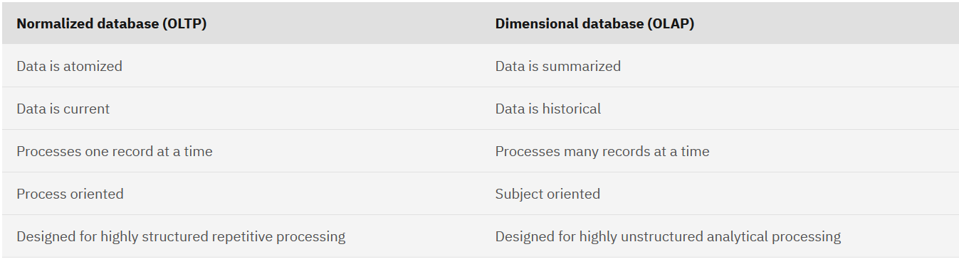
Data model
Source : https://www.ibm.com/docs/en/informix-servers/14.10?topic=databases-why-build-dimensional-database

Slide 11
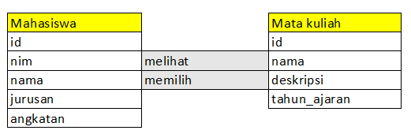
Data model
Relational

Slide 12
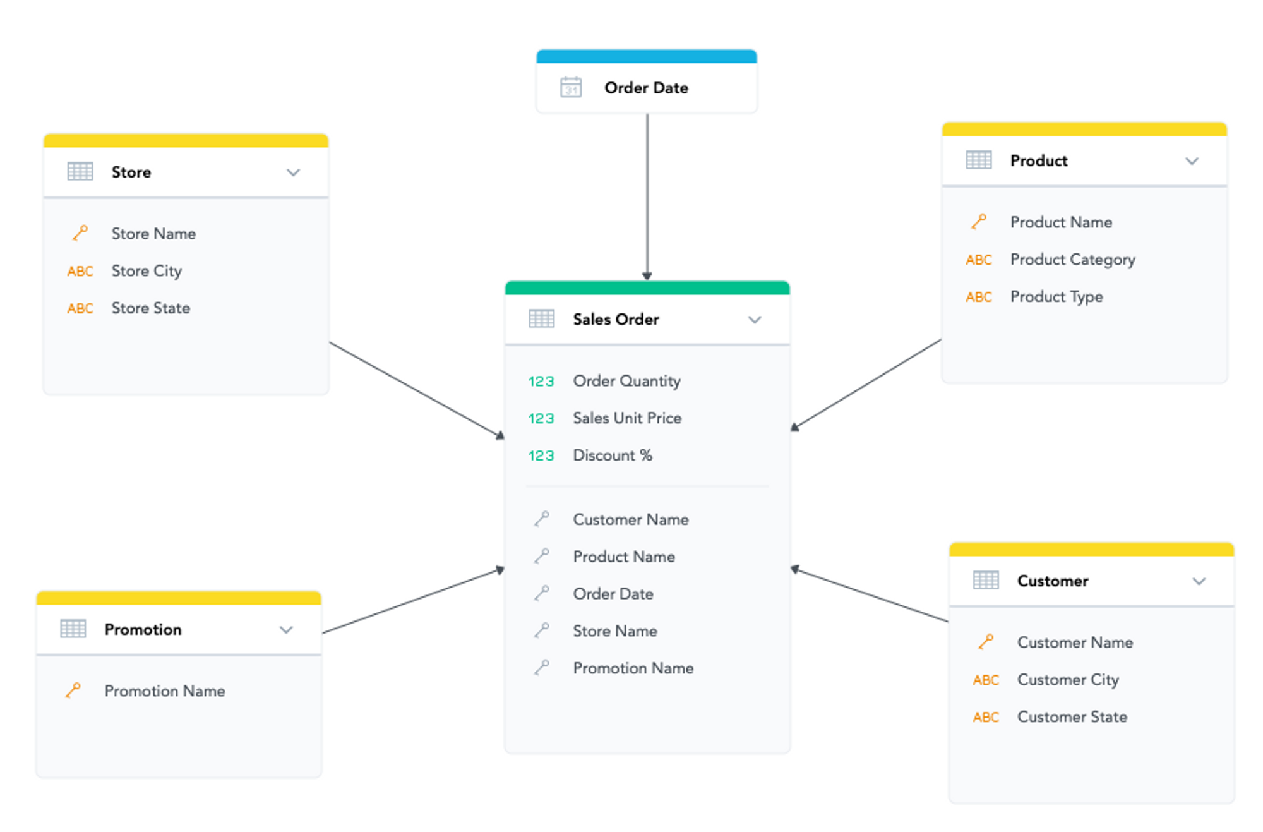
Data model
Dimensional
Source : https://www.gooddata.com/blog/relational-dimensional-data-models

Slide 13
Feature flow
Normal flow/happy path/positive flow
Login :
- User input correct username & password
- User clicks “Login”
- System shows the landing page
Alternate flow/negative flow
Login :
- User input incorrect username & password
- User clicks “Login”
- System shows error popup “Username or password is incorrect”
Pre-condition
Post-condition

Slide 14
Test scenario
Created by QA or Business Analyst
Refer to the requirements such as feature flow, UI mockup, non-functional requirements
Tools (examples)
API test : Postman, Swagger
UI automation test (web) : Selenium
Security test : https://observatory.mozilla.org/
Performance test : JMeter

Slide 15
Test scenario
Positive test scenario
Login
Steps :
User input correct username & password
User clicks “Login”
Expected result :
System shows Dashboard

Slide 16
Test scenario
Negative test scenario
Login – Invalid username or password
Steps :
User input incorrect username or password
User clicks “Login”
Expected result :
System shows error popup “Username or password is incorrect”
Login – Empty username or password
Steps :
User leave username or password field blank
Expected result :
“Login” button disabled

